Slide 1
Predicting Obesity Analysis of Data collected from Mexico, Peru, and Colombia Maryi Tatiana Palacios 2025

Slide 2
Description of the Dataset
This dataset was collected through an online survey of people from Mexico, Peru, and Colombia, aged between 14 and 61 years. The dataset was collected with the goal of predicting obesity levels based on factors like eating habits and physical conditions.
Number of records: 2,111 records Number of variables: 17 variables
Dataset Link: https://archive.ics.uci.edu/dataset/544/estimation+of+obesity+levels+based+on+eating+habits+and+physical+condition

Slide 3
Variables
Variable | Description | Type | Relevance
Gender | Gender | Nominal | Moderate
Age | Age | Continuous | High
Height | Height | Continuous | Moderate
Weight | Weight | Continuous | High
family_history_with_overweight | Has a family member suffered or suffers from overweight? | Binary | Low
FAVC | Do you eat high caloric food frequently? | Binary | High
FCVC | Do you usually eat vegetables in your meals? | Discrete | Moderate
NCP | How many main meals do you have daily? | Continuous | High
CAEC | Do you eat any food between meals? | Nominal | Moderate
SMOKE | Do you smoke? | Binary | High
CH2O | How much water do you drink daily? | Continuous | High
SCC | Do you monitor the calories you eat daily? | Binary | High
FAF | How often do you have physical activity? | Continuous | High
TUE | How much time do you use technological devices such as cell phone, videogames, television, computer and others? | Discrete | Low
CALC | How often do you drink alcohol? | Nominal | Moderate
MTRANS | Which transportation do you usually use? | Nominal | Low
NObeyesdad | Obesity level | Nominal | High

Slide 4
Problem: Predicting Obesity Levels
The objective is to predict the obesity level of individuals, categorizing them into one of seven levels: Insufficient Weight, Normal Weight, Overweight Level I, Overweight Level II, Obesity Type I, Obesity Type II, and Obesity Type III; based on factors such as eating habits and physical conditions.

Slide 5
Machine Learning System
Evaluation
Cleaning
Model selection
Training
Input Data
Prediction
Output

Slide 6
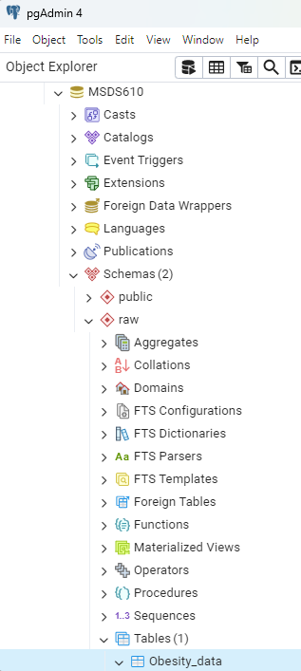
Screenshot - pgAdmin Data

Slide 7
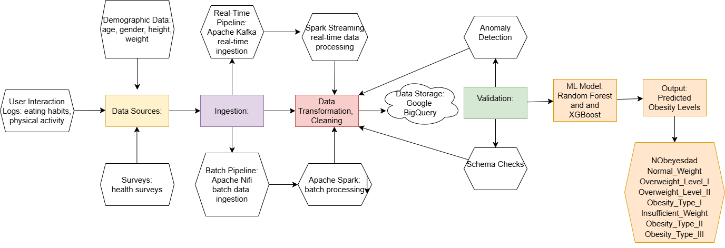
Data Pipeline
Notes:
This pipeline was designed considering the need to process both real-time and batch data. I used technologies like Apache Kafka for ingesting dynamic data like physical activity, eating habits, and Apache Spark to handle large volumes of historical survey data. I chose Random Forest and XGBoost as machine learning models due to their effectiveness in classification, especially in datasets with many interdependent features. This system allows for accurate predictions of obesity levels and provides personalized recommendations based on the available data.

Slide 8
Pipeline Type: (batch + streaming)
I chose a combined pipeline (batch + streaming) because this approach allows me processing both historical data and real time updates.
Data Format: (batch + streaming)
I chose Parquet for storing the processed data because it’s a columnar format, ideal for large datasets, and works great with tools like Apache Spark and Google BigQuery, which I plan to use.
Notes:
Pipeline Type: Batch + Streaming:
The combined pipeline helps me process both old data and real-time data.
Batch processing is used for large amounts of older data, like surveys, that don’t need to be updated instantly.
Streaming is for data that needs to be processed right away, like physical activity and eating habits.
Using both lets me handle different types of data in the best way possible.
Data Format: Parquet:
I chose Parquet because it stores data more efficiently, especially for large datasets.
Parquet works well with tools like Apache Spark and Google BigQuery, making it easier and faster to process the data.

Slide 9
Data Quality Issues
I identified 24 duplicate records and decided to drop them.
I decided to replace 'no' with 'Never' since it makes more sense with the question
Absence of a 'demographic' variable (such as country or city) for a better analysis of obesity levels by region.
Notes:
Duplicate Records:
Validation Check: To monitor for duplicates, I checked for rows with identical values in key columns to ensure no records are repeated. I identified 24 duplicate records in the dataset. To address this, I decided to drop the duplicates to ensure the dataset remains clean and accurate.
Inconsistent Data
I found that the value 'no' was used in some responses. I decided to replace 'no' with 'Never', as it better aligns with the question and makes the data more consistent and understandable.
Validation Check: I would set up a rule to check for values like 'no' and ensure they're replaced consistently with 'Never' to maintain uniformity in the dataset.
Missing Demographic Information:
There is a lack of demographic data, such as country or city, which limits the ability to analyze obesity levels based on geographic regions. Including this data would provide deeper insights and enable better analysis by region.

Slide 10
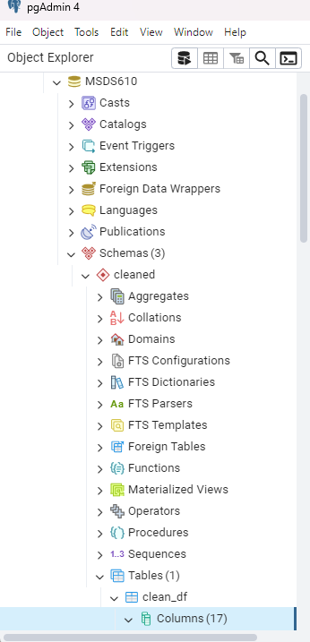
Screenshot
Notes:
I created a new schema called cleaned within the MSDS610 database to organize and store the cleaned and preprocessed data. This schema holds the data after applying the changes presented in the previous slide, such as removing duplicates and handling inconsistent values, and presented the screenshot.

Slide 11

Thank you

